Slide 1


BRIDGING THE GAP
From 4-H Members of Today to Community Leaders & Builders of Tomorrow

Slide 2
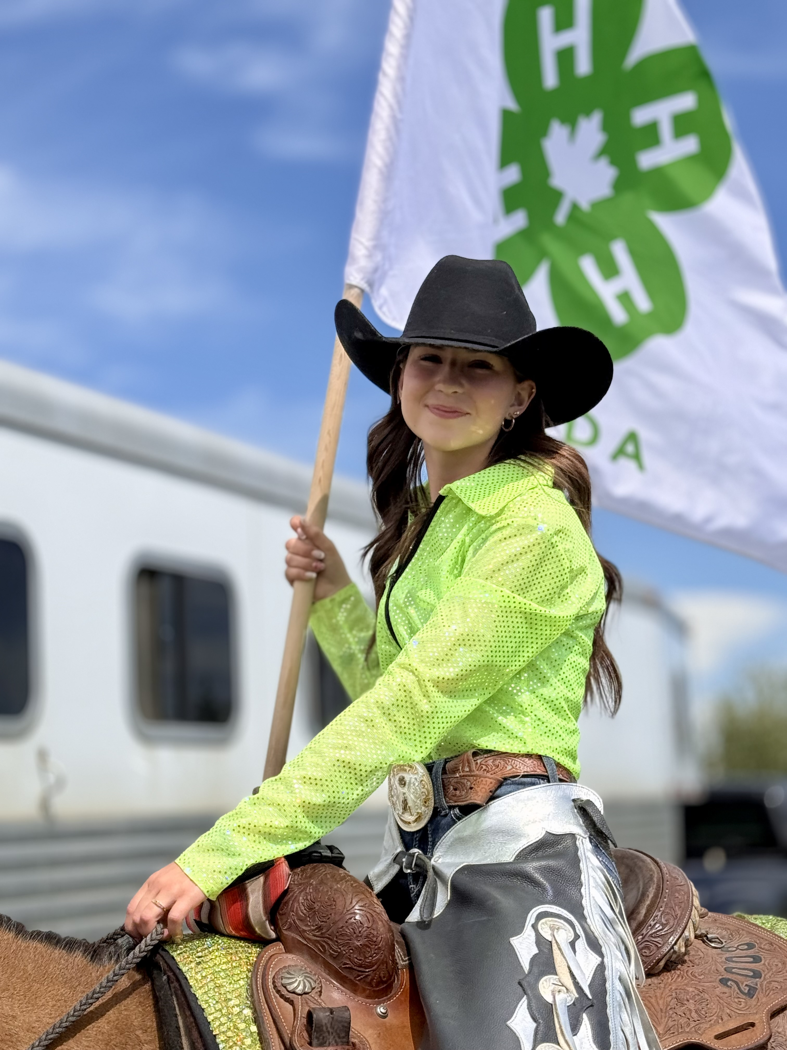
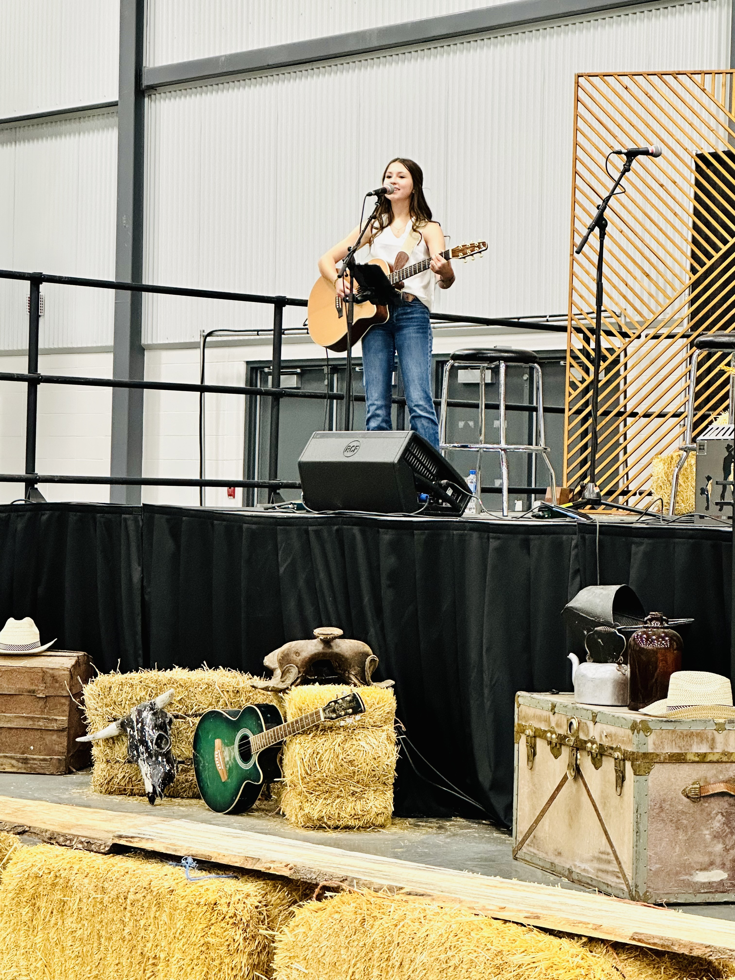
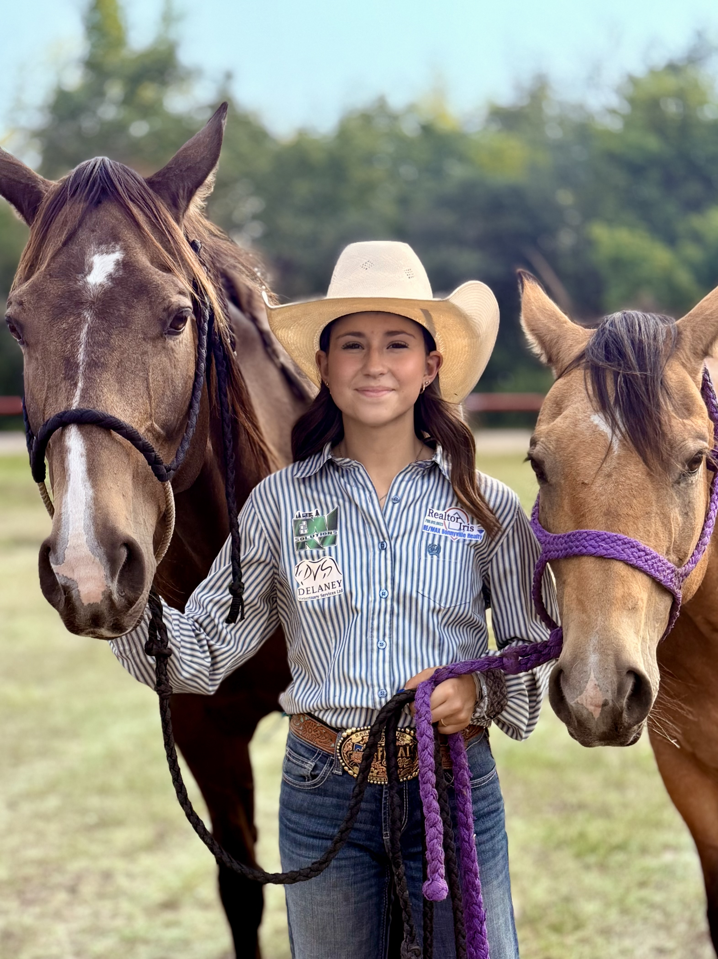
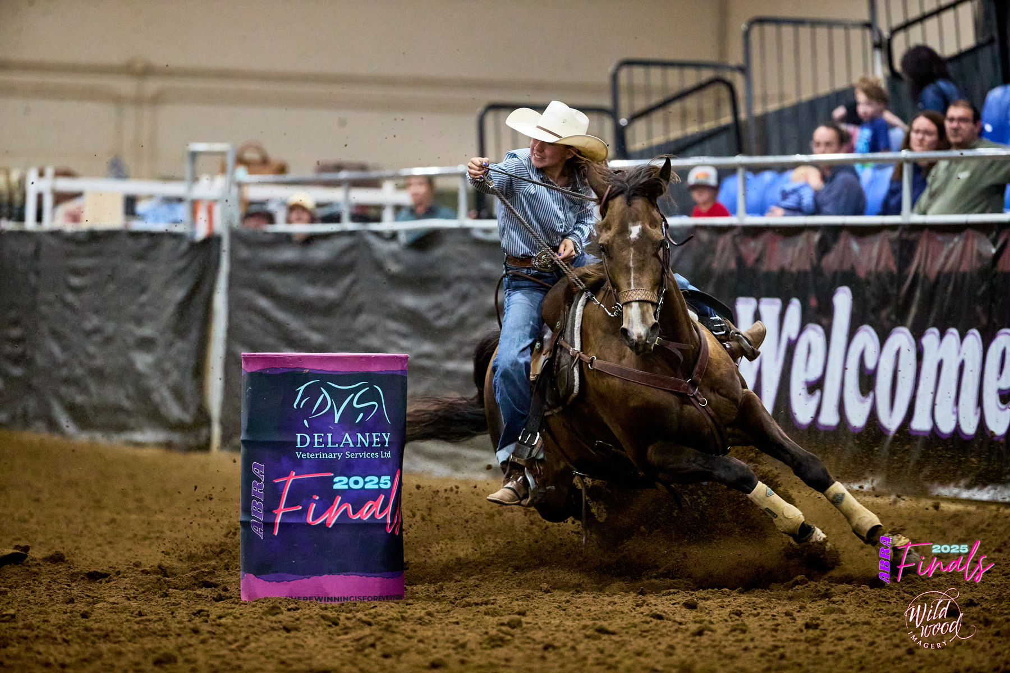
WHO I AM

Slide 3
THE NEXT STEP
How do we bridge the gap between 4-H members today and the community builders and leaders of tomorrow?
  It’s not just about succession
  It’s about passing on passion, pride, and purpose

Slide 4
"We are community builders. Those with the resolve and know-how to orchestrate moments that rally us to each other’s side.“
- CAFE Shared Vision
  CONNECT PEOPLE
  CELEBRATE LEARNING
  STRENGTHEN COMMUNITIES

Slide 5
THE CHALLENGE
Long time volunteers and organizers are retiring
  Youth face busier schedules and more choices
  HOW DO WE STRENGTHEN IT?

Slide 6
INVITE
INVOLVE
INVEST

Slide 7
Step 1: INVITE
Invite youth as decision-makers, not just helpers
  Foster intergenerational collaboration
  Give them seats at the table:
  - youth liaison
  - event planning
  - board member
  - lead new initiatives
  Result: Youth feel heard, valued, and motivated to lead.

Slide 8
Step 2: INVOLVE
Create hands-on leadership experiences
  Hands-On Experience Opportunities:
  - Mentorship Programs
  - Job Shadowing
  - Summer Internships
  - Executive Mentorship
  Let youth apply 4-H skills — teamwork, problem-solving, communication
  Result: They gain real-world confidence and preserve shared culture, ethics and values.

Slide 9
Step 3: INVEST
Invest in people and relationships
  Youth leadership development = the future of our fairs, exhibitions and communities
  Scholarships, workshops, and youth board training
  Result: Stronger, sustainable organizations for generations to come.

Slide 10
BRIDGING BOTH WAYS
“Strengthening organizations that create experiences to enrich communities.“
- CAFE Shared Vision
It’s not just about handing over someday— it’s about sharing leadership
  INNOVATION MEETS WISDOM
  TECHNOLOGY MEETS TRADITION
  EXPERIENCE MEETS ENERGY

Slide 11

THE BIGGER PICTURE
Bridging the gap = ensuring continuity
  Keep traditions alive while evolving with new ideas
  Strengthen community pride and purpose
  Build confident young leaders ready to carry the torch

Slide 12
THE CALL TO ACTION
If we:
  INIVTE youth to the table
  INVOLVE them in meaningful roles
  INVEST in their growth
  Then tomorrow’s leaders will be ready — with fresh ideas, new tools, and the same passion for community.

